Slide 1
Use Cases
Lecturer: Ngo Huy Bien
Software Engineering Department
Faculty of Information Technology
VNUHCM - University of Science
Ho Chi Minh City, Vietnam
nhbien@fit.hcmus.edu.vn

Slide 2

Objectives
To identify a use case.
To write a use case.
To draw a use case diagram.

Slide 3

Contents
Use Cases.
Use Case Diagrams.
Goal Levels.

Slide 4

References
Craig Larman (2004). Applying UML And Patterns.
Grady Booch et al. (2005). Unified Modeling Language User Guide. Addison Wesley Professional.
Alistair Cockburn (2001). Writing Effective Use Cases.

Slide 5
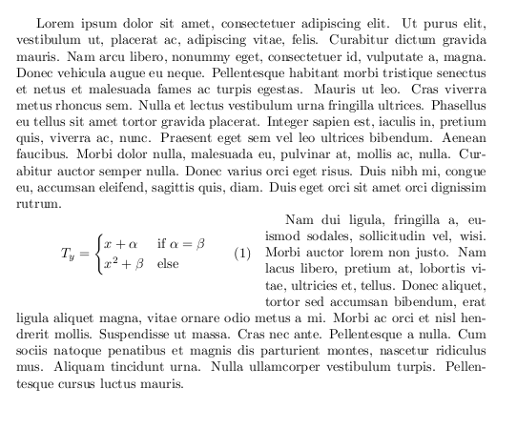



Bad Communication [1]
Lack of user involvement in software projects is near the top of the list of reasons for project failure, so anything that can help keep them involved is truly desirable.

Slide 6
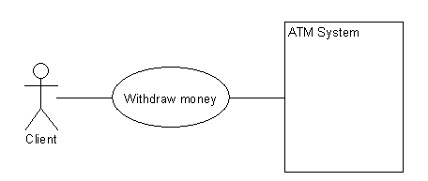
Actor, Action and System
An actor is something with behavior, such as a person (identified by role), computer system, or organization.
Action
Actor
System

Slide 7
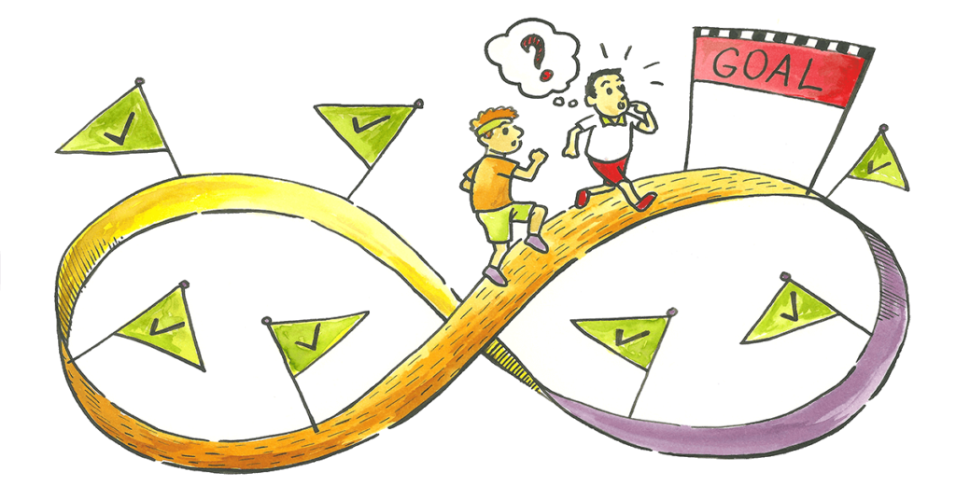
Scenario and Use Case
A scenario is a specific sequence of actions and interactions between actors and the system.
A use case is a collection of related success and failure scenarios that describe an actor using a system to support a goal.
An example brief format use case:
Process Sale:
A customer arrives at a checkout with items to purchase.
The cashier uses the point-of-sale (POS) system to record each purchased item.
The system presents a running total and line-item details.
The customer enters payment information, which the system validates and records.
The system updates inventory.
The customer receives a receipt from the system and then leaves with the items.
Informally, use cases are text stories of some actor using a system to meet goals.

Slide 8
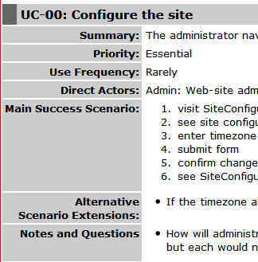
Documenting a Use Case
Name – Unique identifier that describes an achievable goal.
Goal – Briefly describes what the user intends to achieve with this use case.
Summary – Provides a quick overview.
Actor – anything with behavior.
Trigger states what event gets the use case started.
Preconditions state what must always be true before beginning a scenario in the use case.
Steps – Sequence of actions and interactions between actors and the system.
Post-conditions state what must be true on successful completion of the use case.

Slide 9
Three Common Use Case Formats
Use cases can be written in different formats and levels of formality:
brief Terse one-paragraph summary, usually of the main success scenario.
casual Informal paragraph format. Multiple paragraphs that cover various scenarios.
fully dressed All steps and variations are written in detail, and there are supporting sections, such as preconditions and success guarantees.

Slide 10
Example of Casual Format
UC 01: Handle Returns
Main Success Scenario:
A customer arrives at a checkout with items to return.
The cashier uses the POS system to record each returned item …
Alternate Scenarios:
If the customer paid by credit, and the reimbursement transaction to their credit account is rejected, inform the customer and pay them with cash.
If the item identifier is not found in the system, notify the Cashier and suggest manual entry of the identifier code (perhaps it is corrupted).
If the system detects failure to communicate with the external accounting system, …

Slide 11
Example of Fully Dressed Format
Use Case Section | Comment
Use Case Name | Start with a verb.
Scope | The system under design.
Level | "user-goal" or "subfunction"
Primary Actor | Calls on the system to deliver its services.
Stakeholders and Interests | Who cares about this use case, and what do they want?
Preconditions | What must be true on start, and worth telling the reader?
Success Guarantee | What must be true on successful completion, and worth telling the reader.
Main Success Scenario | A typical, unconditional happy path scenario of success.
Extensions | Alternate scenarios of success or failure.
Special Requirements | Related non-functional requirements.
Technology and Data Variations List | Varying I/O methods and data formats.
Frequency of Occurrence | Influences investigation, testing, and timing of implementation.
Miscellaneous | Such as open issues.

Slide 12
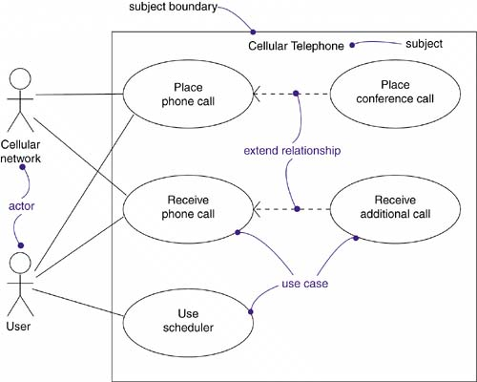
Use Case Diagram
A use case diagram is a diagram that shows a set of use cases and actors and their relationships.
Use cases are text documents, not diagrams, and use-case modeling is primarily an act of writing text, not drawing diagrams.
Use Case Diagram

Slide 13
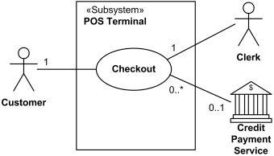
Three Kinds of Actors
An actor is anything with behavior, including the system under discussion (SuD) itself when it calls upon the services of other systems.
Primary actor has user goals fulfilled through using services of the SuD. For example, the cashier.
Supporting actor provides a service (for example, information) to the SuD. The automated payment authorization service is an example.
Offstage actor has an interest in the behavior of the use case, but is not primary or supporting; for example, a government tax agency.

Slide 14
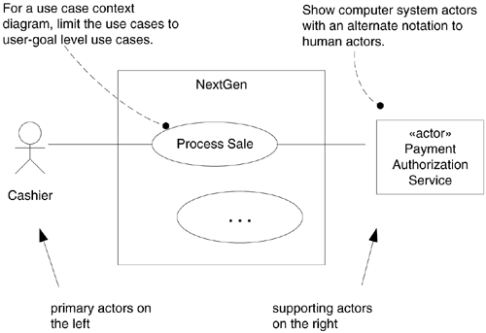
Draw a Use Case Diagram

Slide 15

Black-box Use Cases
Black-box use cases do NOT describe the internal workings of the system, its components, or design.
Black-box style | Not
The system records the sale. | The system writes the sale to a database. …or (even worse): The system generates a SQL INSERT statement for the sale…

Slide 16
How to Find a Use Case?
List business and user requirements (i.e. scenarios and features).
Draw an “initial” version of domain model.
Draw an “quick and dirty” version of UIs.
Choose the system boundary.
Identify the primary actors.
Identify actor’s goal.
Define use case name that satisfies the actor’s goal (a verb).
Identify steps that lead to the actor’s goal.

Slide 17

How to Write a Good Use Case?
Who is the actor?
What does the actor do?
How does the actor interact with the system?
A SCREEN. How does it look like?
What are the inputs from the actor in each step?
NUMBER
STRING
DATE/TIME
TRUE/FALSE
What will the actor receive for each step (outputs)?
A SCREEN. What is in the screen (NUMBER, STRING, DATE/TIME, TRUE/FALSE, LIST)? How does it look like?

Slide 18
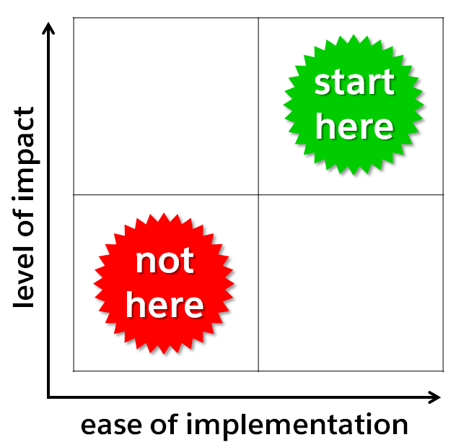
Discovering Good Use Cases

Slide 19
Why Use Cases?
Simple and possible for domain experts or requirement donors to themselves write (or participate in writing).
Emphasize the user goals and perspective.
We ask the question "Who is using the system, what are their typical scenarios of use, and what are their goals?"
This is a more user-centric emphasis compared to simply asking for a list of system features.
The ability to scale both up and down in terms of sophistication and formality.
Use case diagrams, use case relationships, use case packages.

Slide 20

Important Note
It is usually possible to spot a novice use-case modeler (or a serious Type-A analyst!) by an over-concern with secondary issues such as use case diagrams, use case relationships, use case packages, and so forth, rather than a focus on the hard work of simply writing the text stories.

Slide 21
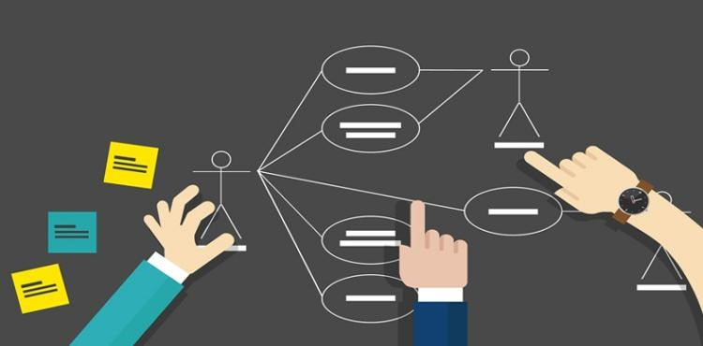
Requirements and Use Cases
Use cases are indeed requirements (although not all requirements).
Some think of requirements only as "the system shall do…" function or feature lists. Not so, and a key idea of use cases is to (usually) reduce the importance or use of detailed old-style feature lists and rather write use cases for the functional requirements.

Slide 22
Business Use Cases
Typically, a use case describes use of one software (or hardware plus software) system; in this case it is known as a system use case.
At a broader scope, use cases can also describe how a business is used by its customers and partners. Such an enterprise-level process description is called a business use case and is a good example of the wide applicability of use cases.
A business use case describe complex workflows involving many parties and concurrent actions.
Refer to “05.2. Business Use Cases.pptx”

Slide 23


Slide 24
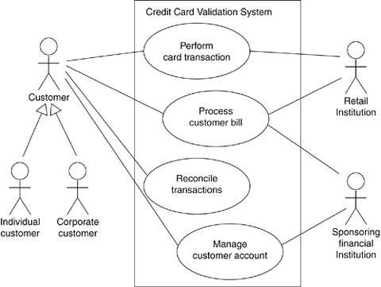
Association Relationship [2]
Actors may be connected to use cases only by association. An association between an actor and a use case indicates that the actor and the use case communicate with one another, each one possibly sending and receiving messages.

Slide 25
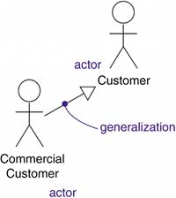
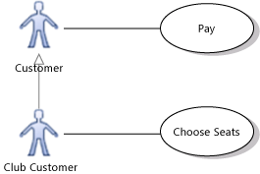
Generalization Relationship – 1
You can define general kinds of actors (such as Customer) and specialize them (such as CommercialCustomer) using generalization relationships.
Generalization of an actor means that one actor can inherit the role of the other actor. The descendant inherits all the use cases of the ancestor. The descendant has one or more use cases that are specific to that role.

Slide 26
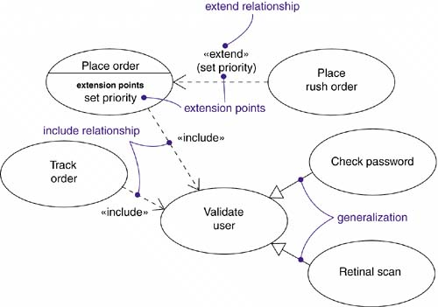
Generalization Relationship – 2
Generalization among use cases is just like generalization among classes.
Here it means that the child use case inherits the behavior and meaning of the parent use case; the child may add to or override the behavior of its parent; and the child may be substituted any place the parent appears (both the parent and the child may have concrete instances).

Slide 27
Include Relationship
An include relationship between use cases means that the base use case explicitly incorporates the behavior of another use case at a location specified in the base.
The included use case never stands alone, but is only instantiated as part of some larger base that includes it.

Slide 28
Extend Relationship
An extend relationship between use cases means that the base use case implicitly incorporates the behavior of another use case at a location specified indirectly by the extending use case.
The base use case may stand alone, but under certain conditions its behavior may be extended by the behavior of another use case.

Slide 29
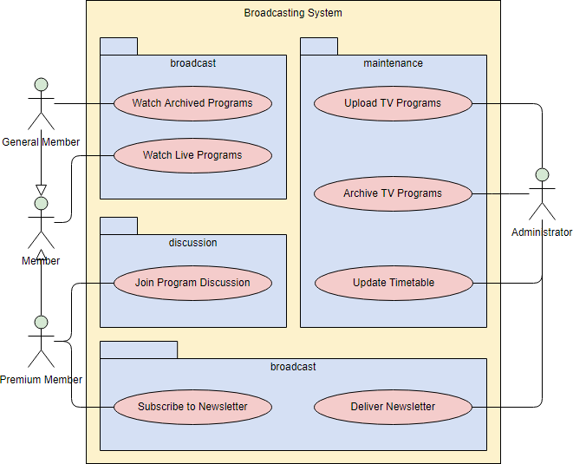
Use Case Packages

Slide 31
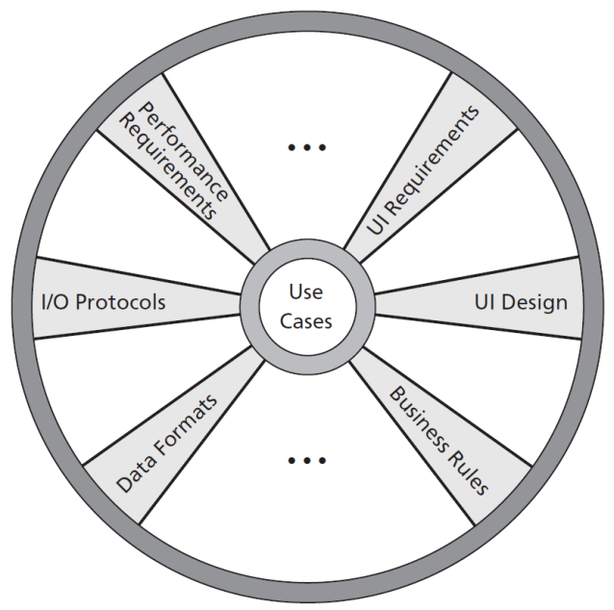
Requirements and Use Cases [3]
If you are writing use cases as requirements, keep two things in mind:
They really are requirements. You shouldn’t have to convert them into some other form of behavioral requirements. Properly written, they accurately detail what the system must do.
They are not all of the requirements. They don’t detail external interfaces, data formats, business rules, and complex formulae. They constitute only a fraction (perhaps a third) of all the requirements you need to collect—a very important fraction but a fraction nonetheless.

Slide 32

Documenting Use Cases
Use cases are fundamentally a text form, although they can be written using flow charts, sequence charts, Petri nets, or programming languages.
Under normal circumstances, they serve as a means of communication from one person to another, often among people with no special training.
Simple text is, therefore, usually the best choice.

Slide 33

How to Write Good Use Cases?

Slide 34
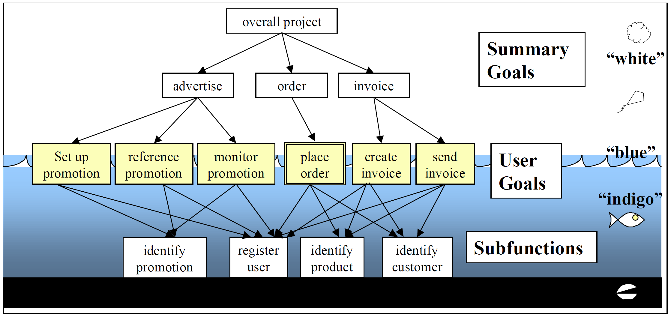
Three Named Goal Levels

Slide 35

User Goals (BLUE, SEA-LEVEL )
The user goal is of the greatest interest.
It is the goal the primary actor has in trying to get work done or the one the user has in using the system.
It corresponds to “elementary business process” in business process engineering.
A user goal addresses the question “Can the primary actor go away happy after having done this?”

Slide 36
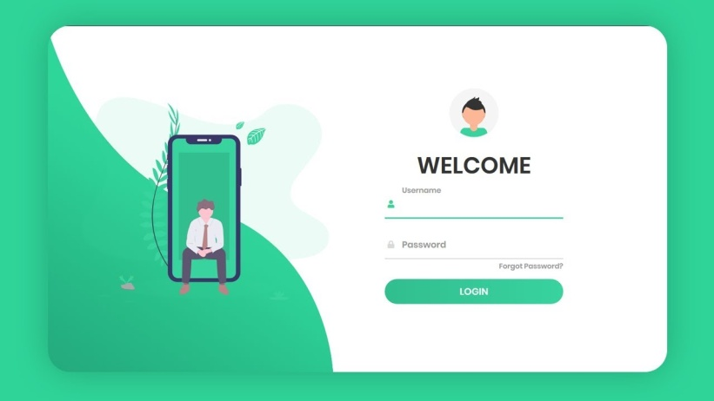
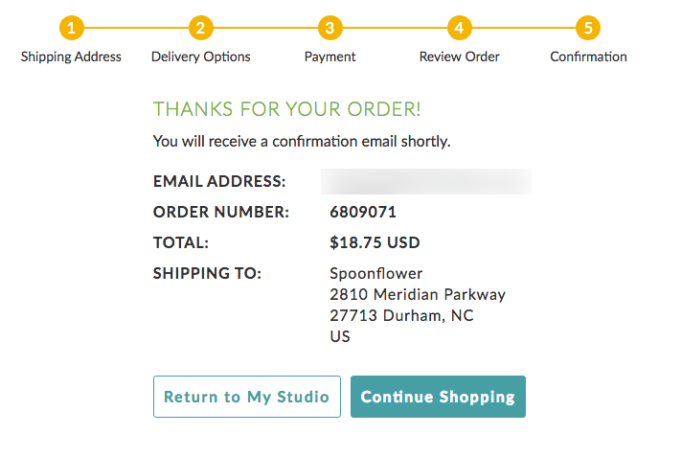
User Goal Examples
Neither “Complete an online auction purchase” nor “Log on” generally counts as a user goal. Online auctions take several days and so fail the single-sitting test.
“Register a new customer” and “Buy a book” are likely to be user goals. Registering 42 new customers has some significance to a sales agent. A book purchase can be completed in a single sitting.

Slide 37
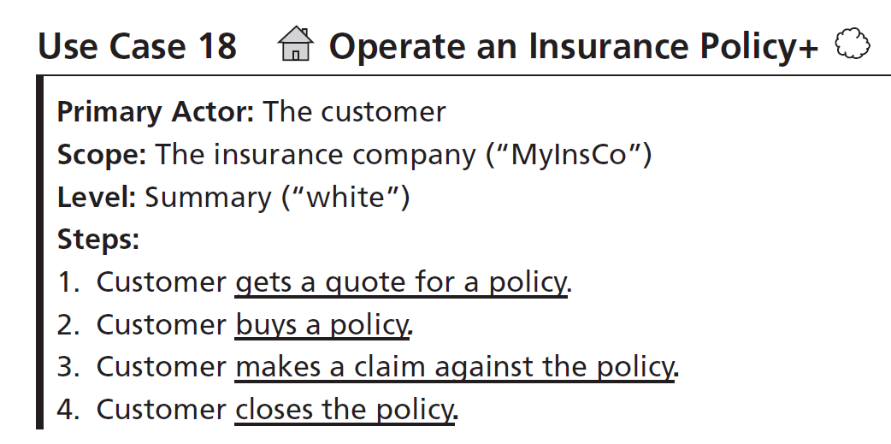
Summary-Level Goals (WHITE, CLOUD / KITE )
Summary-level goals involve multiple user goals. They serve three purposes in describing the system:
They show the context in which the user goals operate.
They show life-cycle sequencing of related goals.
They provide a table of contents for the lower-level use cases, both white and blue.

Slide 38
Subfunction-Level Goals (INDIGO / BLACK, UNDERWATER / CLAM )
Subfunction-level goals are those required to carry out user goals. Include them only as you have to—they are needed on occasion for readability or because many other goals use them.
Examples of subfunction use cases are Find a Product, Find a Customer, and Save as a File.
Those we color black to mean “This is so low level, please don't even expand it into a use case”.

Slide 39
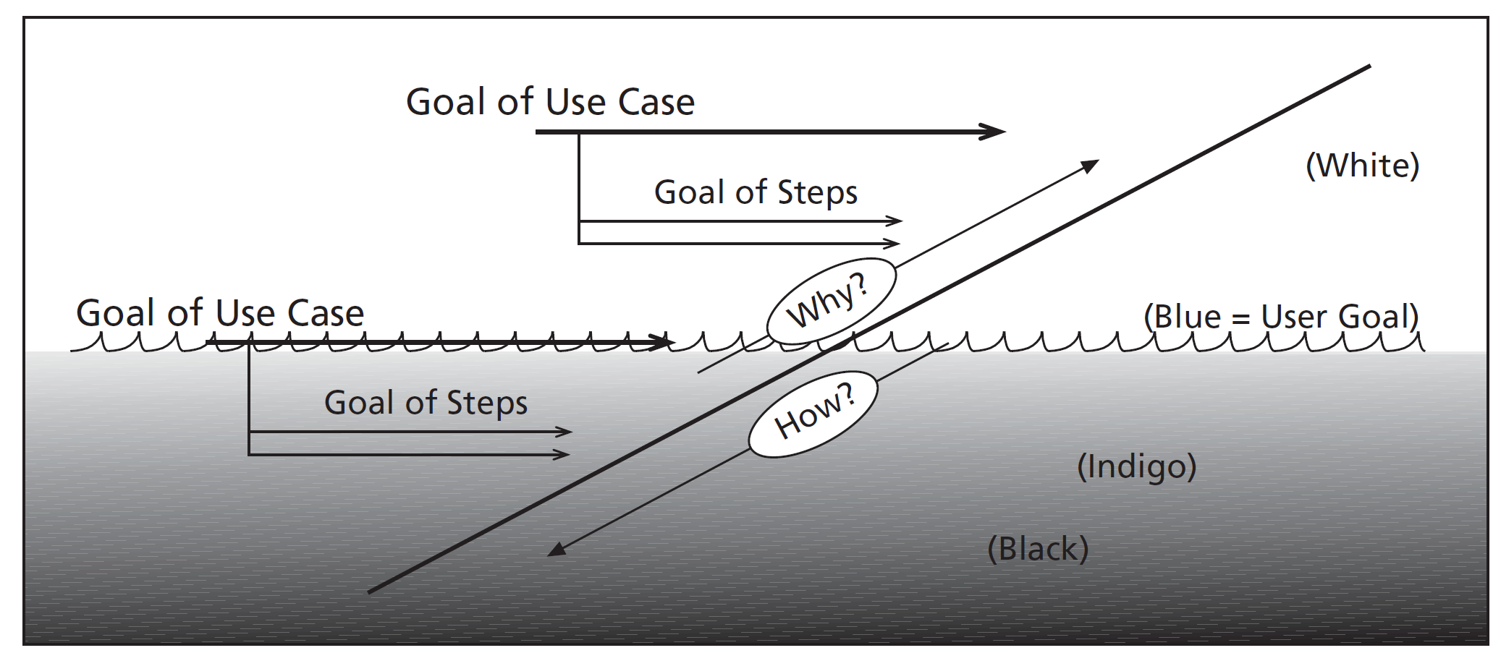
Finding the User’s Goal
What does the primary actor really want?
Why is this actor doing this?
Ask “why” to shift levels.

Slide 40

Thank You & See You Again

